Slide 1
BTP Endsem Evaluation
Supervised by -
Dr. Asif Ekbal
Associate Professor
Department of CSE
IIT Patna
Name - Saurav Dudhate
Roll No - 2001CS62

Slide 2
Problem Definition
The main goal is to develop Conversational Agents with Persuasion and Negotiation Abilities.
3 aspects :
Persuasion
Influencing
Negotiation

Slide 3
Work Done
Evaluation of LLMs in various kinds of conversational setups
Creation of test set out of dataset selected
Generating 50 zero-shot, one-shot and few-shot prompts
Evaluation based on various scores such as METEOR, BLEU, ROUGE, BERTScore
Human evaluation of prompts based on various factors
Influencing component of the model :
Creation a set of communication flows in order to make a blueprint for dataset generation
Generation of dataset on basis of these communication flows using LLMs
Running codes for the influencing module
Creating a KG as a component of influencing module
Raw data extraction from wikipedia
Selection of relations relevant to our setup
Generation of triples
Leveraging Knowledge Integration in Language Models

Slide 4
Evaluation of LLMs

Slide 5
Datasets
Persuasion for Good dataset :
1017 human to human conversations for charity named Save the Children
Annotation done using 32 emotion labels, with the use of Emphatetic Dialogues dataset.

Slide 6
Methodology
Creation of test set
Human like responses excluded
Variety of conversations included : Mathematical figures, Logical Reasoning
3 or 5 dialogues from extracted from conversation depending on bot response
Prompt length restricted upto 256 tokens for zero shot and 512 tokens for one and few shot

Slide 7
Methodology
15 test samples per test set
All context-response pairs correspond to similar generated response type
Zero shot - 1 context, create a response
One shot - 1 context-response pair, 1 context, create a response
N shot - N context-response pair, 1 context, create a response
Test for following models :
Alpaca
Falcon
Llama

Slide 8
Methodology
Human Evaluation :
Generic Metrics :
Fluency
Non-repetitiveness
Correctness / Context relevance
Task-specific Metrics :
Politeness
Empathy
Assigned scores from 1-5

Slide 9
Methodology
Automatic Evaluation :
BLEU Scores
METEOR Scores
ROUGE Scores
BERT Scores
Embedding Average
Vector Extrema
Greedy Matching

Slide 10
Results
https://docs.google.com/spreadsheets/d/1xYEehowwxfH6T1dOosMNJ9uGInPxHizsIPsYxhkFKMw/edit?usp=sharing

Slide 11
 | Zero-shot | One-shot | Two-shot
Bleu 1 | 0.060254 | 0.073916 | 0.068778
Bleu 2 | 0.016737 | 0.024656 | 0.019678
Bleu 3 | 0.007238 | 0.010158 | 0.007978
Bleu 4 | 0.003832 | 0.005016 | 0.003637
METEOR | 0.048444 | 0.051008 | 0.038142
ROUGE_L | 0.052981 | 0.060195 | 0.048614
BERTScore | 0.8086200356 | 0.8111463189 | 0.799346447
EmbeddingAverageCosineSimilarity | 0.754511 | 0.743256 | 0.642455
VectorExtremaCosineSimilarity | 0.389199 | 0.392213 | 0.387520
GreedyMatchingScore | 0.706590 | 0.714014 | 0.695073

Slide 12
Influencing

Slide 13
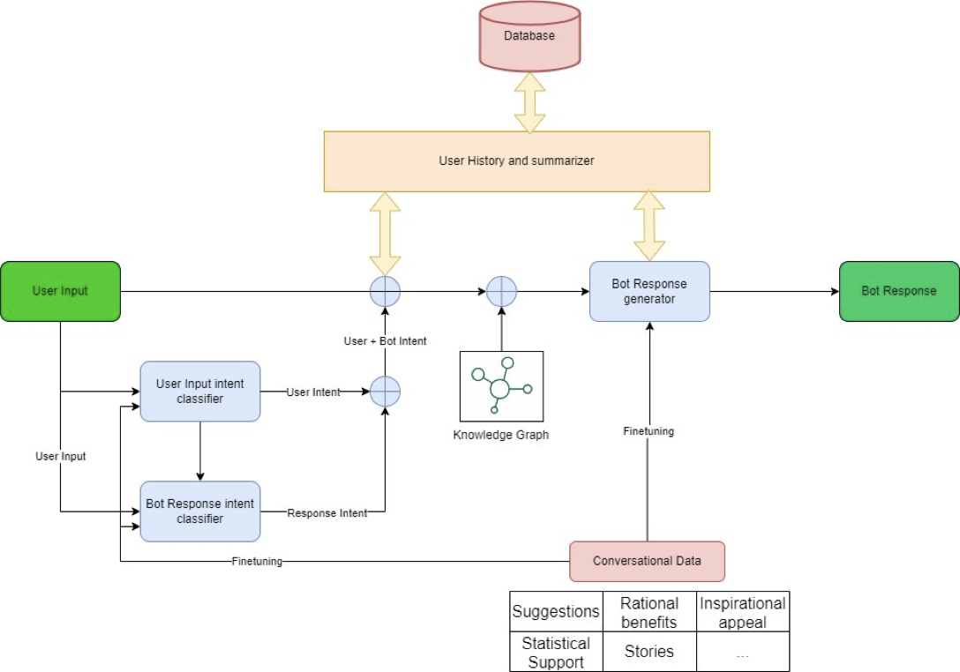
Architecture

Slide 14
Reward Functions
R_total = ∑[For all support_types] (w_i * R_i) + w_diversity * D
∑[i in support_types] (w_i * R_i) s the sum of rewards for each support type, weighted by their importance.
w_diversity is the weight assigned to the diversity reward.
D is the diversity score, which measures how evenly the agent uses different support types.
w_i depends on persona and compliance rate
Inspirational appeal: 0.9
Rational benefits: 0.5
Statistical Support: 0.7
Stories Support: 0.7

Slide 15
Example of Communication Flow
In 1st conversation, User says hello, a suggestion is introduced, user is interested, asks bot about further details and says will get back. \
In 2nd conversation, user says it is happy with the suggestion but puts forth certain questions as in FAQs, the bot clarifies and the conversations ends with user satisfied. \
In 3rd conversation, the user is convinced with the given suggestion but wants to look for a couple of additional features, the bot provides the same. \
In 4th conversation, the user checks out the other suggestion and holds another series of queries with the bot.\
In 5th conversation, the user thanks the bot for the help. \

Slide 16
Creation of Knowledge Graph

Slide 17
Raw Data Extraction from Wikipedia
Why use Wikipedia?
Wikipedia offers a wide range of content on various topics related to environmental conservation.
Data in wikipedia is well structured under various headings and sections.
Open accessibility and availability of data to the public on wikipedia is the main reason for using it for Data Extraction.

Slide 18
KG creation process
Knowledge graphs provide a structured representation of information using entities and relations.
Entities: These are fundamental elements, representing entities like people, places, concepts, and objects.
Relations: They define connections or interactions between entities, adding contextual depth to the information.
In a knowledge graph, entities and relations work together to form a comprehensive understanding of the data.

Slide 19
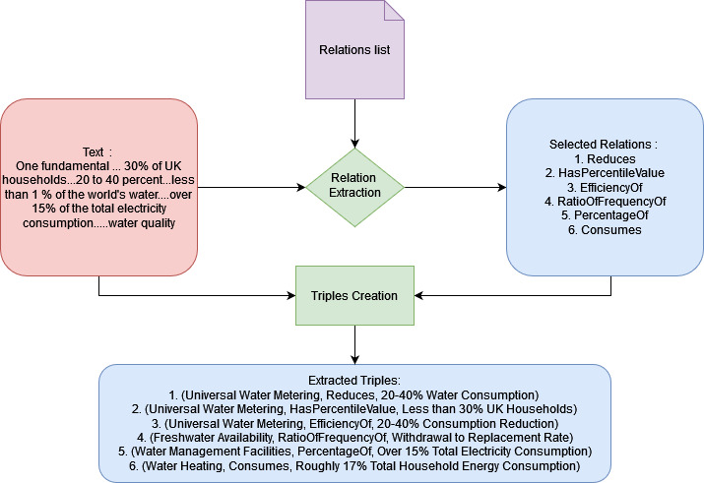
KG Creation Process

Slide 20
Emphasizing Relation-Centric Approach
Benefit: Opting for a relation-centric approach in knowledge graph creation offers distinct advantages.
Entities Abundance: Entities can be numerous and varied, potentially leading to information overload and complexity.
Highlight: Prioritizing relations over entities streamlines the representation, simplifying the structure of the knowledge graph.
Conclusion: By emphasizing relations, we enhance the efficiency of knowledge representation, ensuring a more focused and meaningful knowledge graph. This approach helps in managing the potential endlessness of entities while maintaining the richness of the information.

Slide 21
KG Creation
Some of the topics chosen are:
Renewable Energy
Climate Change
Greenhouse Gas Emissions
Carbon Footprint
Sustainable Development
Biodiversity Conservation
Ecological Footprint
Circular Economy
Clean Energy
Energy Efficiency
Some of the KGs chosen for relation extraction are :
YAGO
Wikidata
DBpedia
Freebase
OpenCyc

Slide 22
Utilizing KG
We employ an embedding-based matching technique to align the context C with relevant triples Ti extracted from the knowledge graph KG. The embedding-based matching function M is defined as:
M (C, KG) = {T1, T2, ..., Tn}
where Ti represents the ith relevant triple identified based on its semantic similarity to the context C. Once the relevant triples are identified, we convert them into coherent sentences that can seamlessly integrate into the generated response. The conversion function F is defined as:
F (Ti) = Si
where Si represents the sentence derived from the i-th triple Ti, ensuring grammatical correctness and contextual relevance.

Slide 23
Leveraging Knowledge Integration in LMs

Slide 24
Enhancing Language Model Responses with Curated Knowledge Graphs
Ensuring Factual Accuracy:
Incorporating curated knowledge graphs mitigates the risk of hallucinations in language model responses.
Provides a robust foundation of empirical data to support generated text.
Improving Coherence:
Embedding-based matching aligns context with relevant knowledge graph triples, enhancing coherence in responses.
Conversion of triples into coherent sentences ensures seamless integration into generated text.
Enriching Responses:
By integrating factual information from curated knowledge graphs, responses are enriched with contextually relevant content.
Language models produce more informed and accurate outputs, bolstering trustworthiness and reliability.

Slide 25

Enhancing Language Model Responses with Curated Knowledge Graphs
Four language models (LM) employed for text response generation.
GPT-2
Godel
Llama-2
Chat-GPT
Embedding-based Matching Technique:
Aligns context (C) with relevant triples (Ti) extracted from KG.
Matching function (M) identifies relevant triples based on semantic similarity to the context.

Slide 26

Enhancing Language Model Responses with Curated Knowledge Graphs
Conversion Function:
Converts identified triples into coherent sentences (Si) for seamless integration into response.
Ensures grammatical correctness and contextual relevance of integrated knowledge.
By incorporating these sentences into the language model's output, we enrich the generated response with factual information grounded in empirical data, thereby reducing the risk of hallucinations..

Slide 27
Original | Triple | Generated Response
The agency estimates that metering alone can reduce consumption by 20 to 40 percent. | (Universal Water Metering, Reduces, 20-40% Water Consumption) | Consider implementing Universal Water Metering to achieve a significant 20-40% reduction in water consumption.
Recent studies have estimated that water supplies are metered in less than 30% of UK households. | (Universal Water Metering, HasPercentileValue, Less than 30% UK Households) | Opting for Universal Water Metering could benefit, as less than 30% of UK households currently have this water-saving measure.
In some regions of the world, over 15% of the total electricity consumption is devoted to water management. | (Water Management Facilities, PercentageOf, Over 15% Total Electricity Consumption) | Improve energy conservation by addressing Water Management Facilities, which currently contribute over 15% to total electricity consumption.
Mostly destined for the shower, it accounts for roughly 17% of total household energy consumption. | (Water Heating, Consumes, Roughly 17% Total Household Energy Consumption) | Save on household energy costs by looking into more energy-efficient water heating solutions, which currently consume roughly 17% of total energy.
Manufacturers of recycling showers typically claim a 70% to 90% reduction in shower energy consumption. | (Recycling Showers, PercentageOf, 70-90% Reduction in Shower Energy Consumption) | Consider investing in recycling showers for a substantial 70-90% reduction in energy consumption.
159 million people worldwide drink water directly from surface water sources, such as lakes and streams. | (Access to Safe Water, PercentageOf, 159 million people worldwide drink water directly from surface water sources) | Highlight the importance of providing safe water sources, as 159 million people globally currently rely on surface water for drinking.
Nearly 1.2 trillion gallons of water is used in the United States annually just for showering. | (Shower Usage, PercentageOf, Nearly 1.2 trillion gallons of water used annually in the United States) | Contribute to water conservation efforts by being mindful of shower usage, which accounts for nearly 1.2 trillion gallons of water annually in the United States.

